Slide 1
Microservice Architecture
What is Microservice
Monolithic Vs SOA Vs Microservice Architecture
Advantages of Microservices
Disadvantages of Microservices

Slide 2
Principles of Microservice Architecture
Independent & Autonomous services
Scalability
Decentralization
Resilient Services
Realtime Load balancing
Availability
CI/CD DevOps
Seamless API integration & Continuous monitoring
Isolation from failures
Auto-provisioning

Slide 3
Design Patterns of Microservice
Aggregator Pattern
API gateway Pattern
Chain of Responsibility Pattern
Synchronous Pattern
Asynchronous Pattern
Data base per service / shared data base pattern
Event sourcing Pattern
Branch Pattern
CQRS Pattern
Circuit Breaker Pattern
Decomposition Pattern

Slide 4
Challenges of Microservices Architecture
Bounded Context
Dynamic Scale up and Scale Down
Monitoring
Fault Tolerance
Cyclic dependencies
DevOps Culture

Slide 5
Spring Cloud Components
Configuration
Service Discovery & Service Registry
Circuit Breakers
Routing and Messaging
API Gateway
Tracing
CI Pipeline

Slide 6
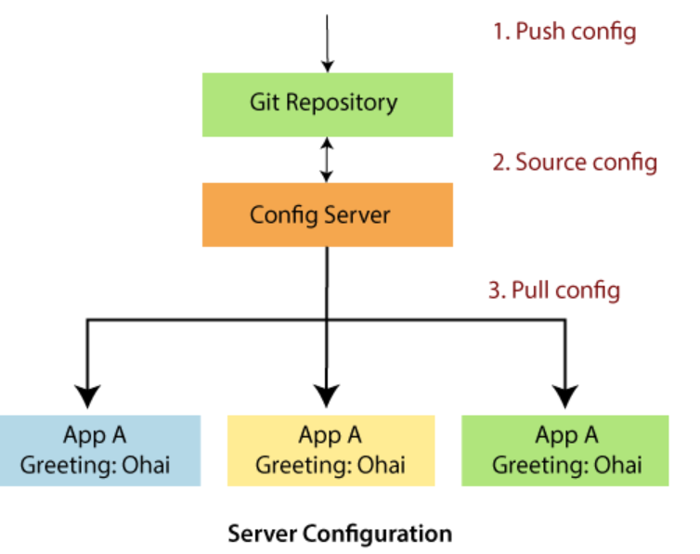
Configuration
Spring Cloud configuration components provide server-side and client-side support for externalized configuration in a distributed system.
We can manage the external properties with config server for applications across all environments.
Spring Cloud config server can use Git, SVN filesystem, and Vault to Store config.
Config clients (microservice app) retrieve the configuration client from the server on startup.

Slide 7
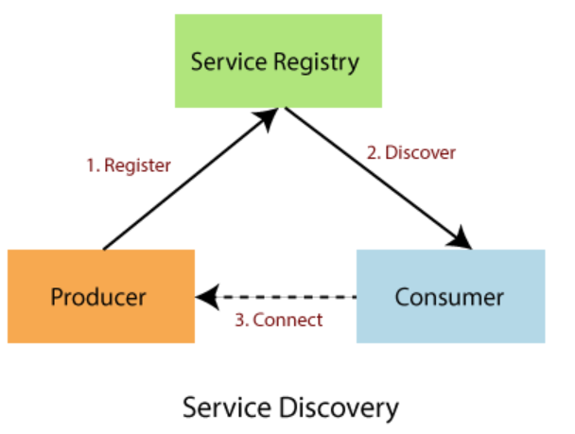
Service Discovery & Registry
The service discovery is the automatic detection of devices and services over the network
Eureka naming server is an application that holds information about all client service applications. Each microservice registers itself with the Eureka naming server.
Client-side discovery:
In the Client-side discovery, client is responsible for determining the network location of available services.
The client uses a load-balancing algorithm to select one of the available services and make a request.
Eg: Netflix OSS Eureka
Server-side discovery:
In the server-side discovery, the client makes an HTTP request to a service through a load balancer.
The load balancer contacts to service registry and route each request to an available service instance.
Service instances are registered and deregistered with the service registry. Eg: AWS ELB

Slide 8
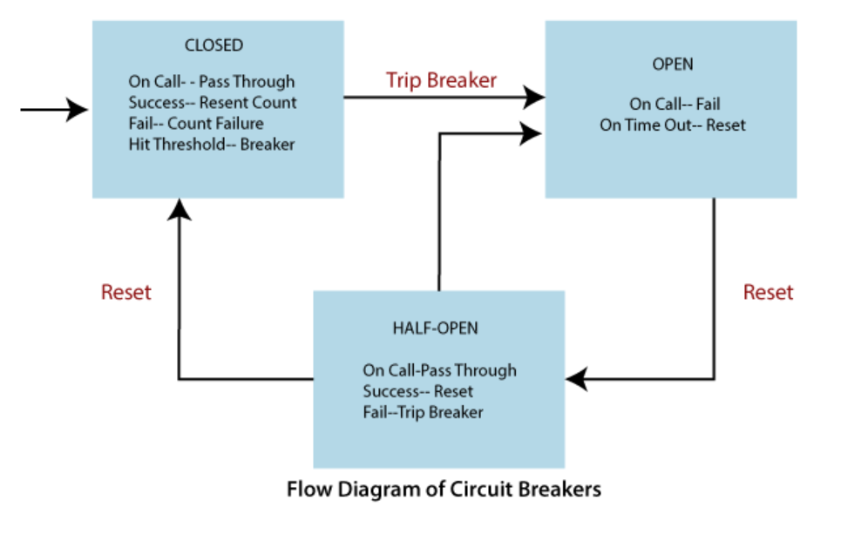
Circuit Breakers -Hystrix
Circuit breakers calculate when to open and close the circuit and what to do in case of failure. When all services fail at some point, the circuit breaker handles these failures gracefully
The circuit breakers have three states: OPEN, CLOSED, and HALF-OPEN State.
CLOSED State: All calls pass through to the supplier microservices. It responds without any latency.
OPEN State: The circuit breaker returns an error calls without executing the function.
HALF-OPEN State: The circuit turns to HALF-OPEN state when a function execution is timed out. It test that underlying problem still exists or not.
It is a monitoring and feedback mechanism. It makes a trial call to supplier microservices to check if it has recovered. If the call to the supplier is timed out, then the circuit remains in the OPEN state. If the call return success, the circuit-switched to the CLOSED state. The circuit breaker returns all external calls to the service with an error during the HALF-OPEN State.

Slide 9
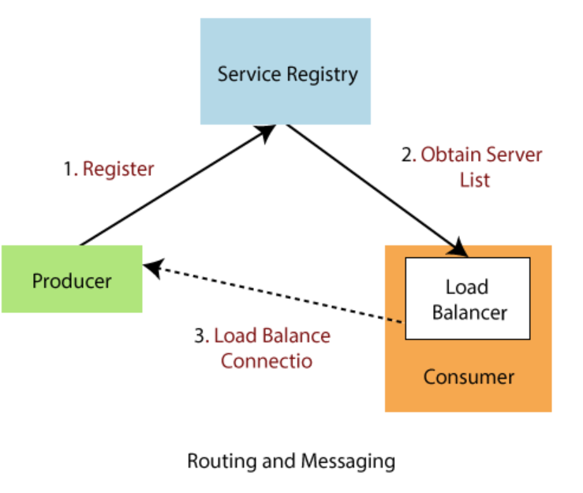
Routing and Messaging
The cloud application made up of many microservices so the communication will be critical.
Spring Cloud supports communication via messaging or HTTP request.
Routing uses Netflix Ribbon &
Open Feign while messaging uses Kafka or Rabbit MQ.

Slide 10
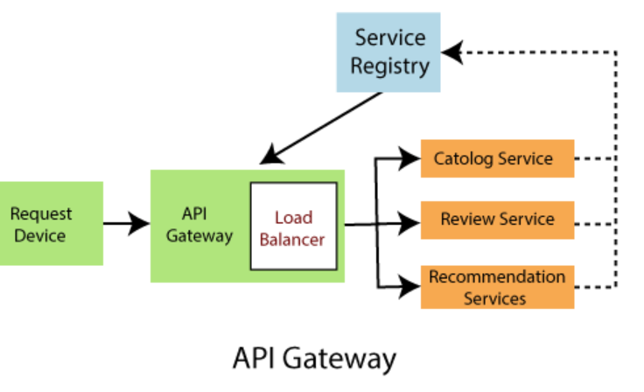
API Gateway
API Gateway allows us to route API request (external or internal) to connect services.
API gateway is a single entry point for all clients
Some requests are simply proxied/routed to the appropriate service.
Other requests by fanning out to multiple services.
Features of API Gateway
Able to match routes on any requested attribute
Predicates and filters are specific to routes
Hystrix circuit Breaker integration
Spring Cloud Discovery Client integration
Easy to write Predicates and filters
Eg: ZUUL, NGiNX
https://engineering.opsgenie.com/comparing-api-gateway-performances-nginx-vs-zuul-vs-spring-cloud-gateway-vs-linkerd-b2cc59c65369

Slide 11
Tracing
Tracing is a single request to get data from the application.
Add Spring Cloud Sleuth library in the project to enable tracing.
Sleuth is responsible for recording timing, which is used for latency analysis.
We can export this timing to Zipkin.
Zipkin is a distributed tracing tool specially designed for analyzing latency problem inside the microservice architecture.
It exposes HTTP endpoint used for collecting input data
Use spring-cloud-sleuth-stream to Zipkin dashboard to get the consolidated data.
Similarly in AWS : Cloud trail and Cloud trace and amazon streams.

Slide 12
CI Pipeline and Testing
Spring Cloud pipeline is an opinionated (self-important) pipeline for Jenkins and Concourse, which creates pipeline automatically for the application. The building, testing, and deploying in various services is critical to having a successful cloud-native application.
The pipeline has two syntaxes: Declarative and Scripted pipeline. These syntaxes are divided into two parts: Steps, and Stages.
Steps are the fundamental part of the pipeline as they tell the Jenkins server what to do.
Stages are the major part of a pipeline.
Stages logically group a couple of steps, which displayed on the pipeline's result screen.

